Slide 1
Naïve Bayes Classifier for Continuous-valued Data

Slide 2
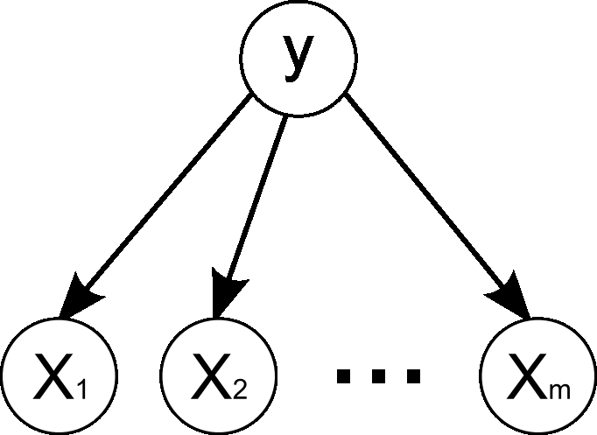
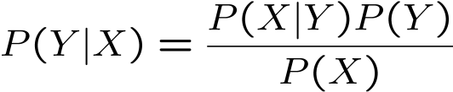
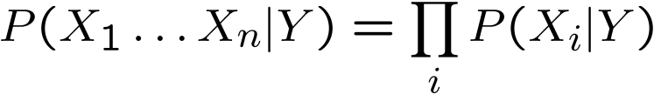
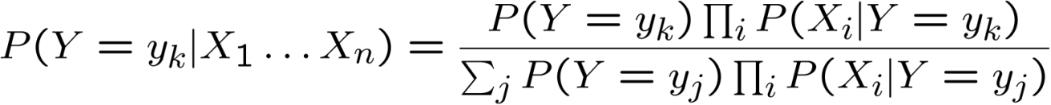
Naïve Bayes --- Recap
Bayes’ Rule
Naïve Bayes assumes conditional independency
Then the inference of posterior is

Slide 3
Naïve Bayes --- Recap
Training: Observation is multinomial (multiple features) and supervised (with label information)
Maximum Likelihood Estimation (MLE)
Classification with Maximum a Posteriori (MAP) rule

Slide 4
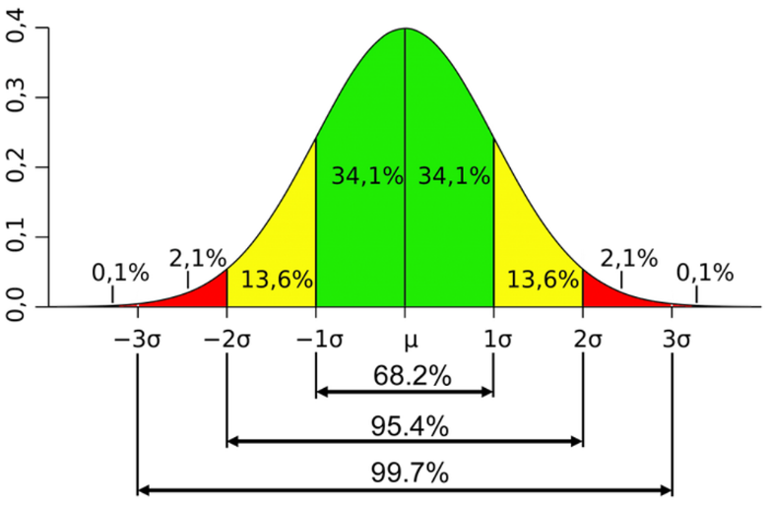
Naïve Bayes
Continuous-valued Input Attributes
What if we have continuous values for an attribute?
E.g., age, height, humidity, strike rate, etc.
What about the Normal (Gaussian) Distribution?

Slide 5
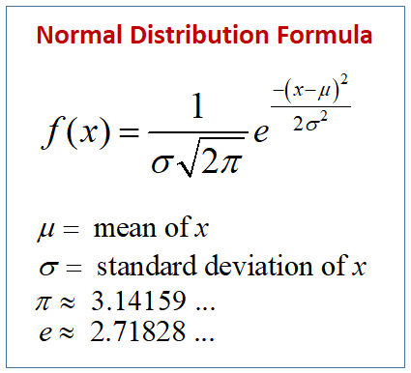

Normal (Gaussian) Distribution

Slide 6
Naïve Bayes: continuous-valued data
Conditional probability modeled with the normal distribution:
Learning Phase:
Output: normal distributions and
Test Phase:
Calculate conditional probabilities with all the normal distributions
Apply the MAP rule to make a decision

Slide 7
Naïve Bayes
Example: Continuous-valued Features
Temperature is naturally of continuous value.
Yes: 25.2, 19.3, 18.5, 21.7, 20.1, 24.3, 22.8, 23.1, 19.8
No: 27.3, 30.1, 17.4, 29.5, 15.1
Learning Phase: Estimate mean and variance for each class
Output 2 Gaussian models for P(temp|C)

Slide 8
Naïve Bayes
Example: Continuous-valued Features
Temperature is naturally of continuous value.
Yes: 25.2, 19.3, 18.5, 21.7, 20.1, 24.3, 22.8, 23.1, 19.8
No: 27.3, 30.1, 17.4, 29.5, 15.1
Test Phase:
Calculate conditional probabilities with the 2 normal distributions: and
Apply the MAP rule to make a decision

Slide 9
Naïve Bayes: continuous-valued data
See the gender classification example
https://en.wikipedia.org/wiki/Naive_Bayes_classifier

Slide 10
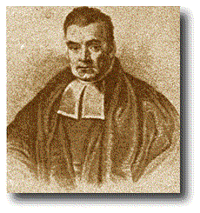
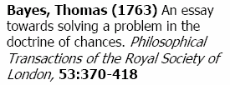

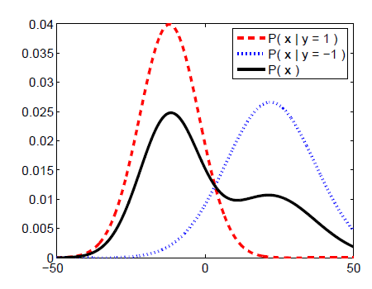
Bayes Formula

Slide 11
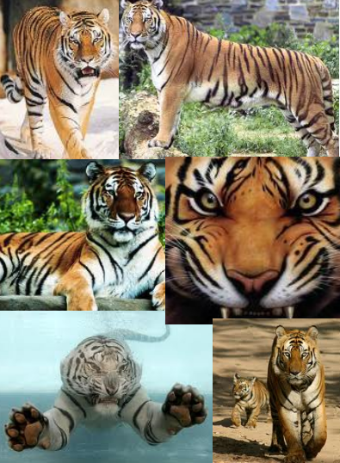

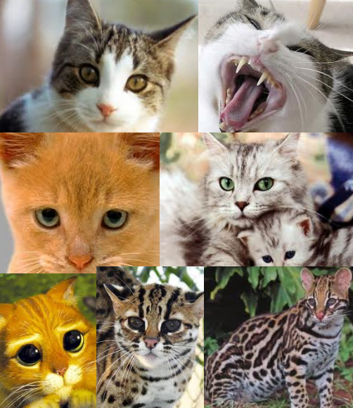
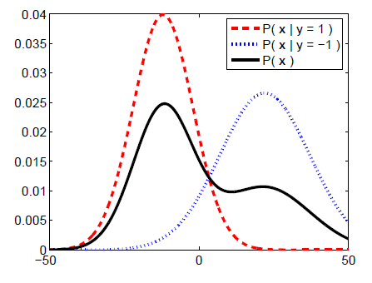
Generative Model
Color
Size
Texture
Weight
…

Slide 12
Numerical Stability
It is often the case that machine learning algorithms need to work with very small numbers
Imagine computing the probability of 2000 independent coin flips
MATLAB thinks that (0.5)²⁰⁰⁰ = 0

Slide 13
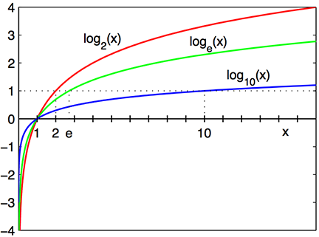
Underflow Prevention
Multiplying lots of probabilities
floating-point underflow
Recall: log(xy) = log(x) + log(y)
➔ better to sum logs of probabilities rather than multiplying probabilities

Slide 14
Underflow Prevention
Class with highest final un-normalized log probability score is still the most probable.

Slide 15
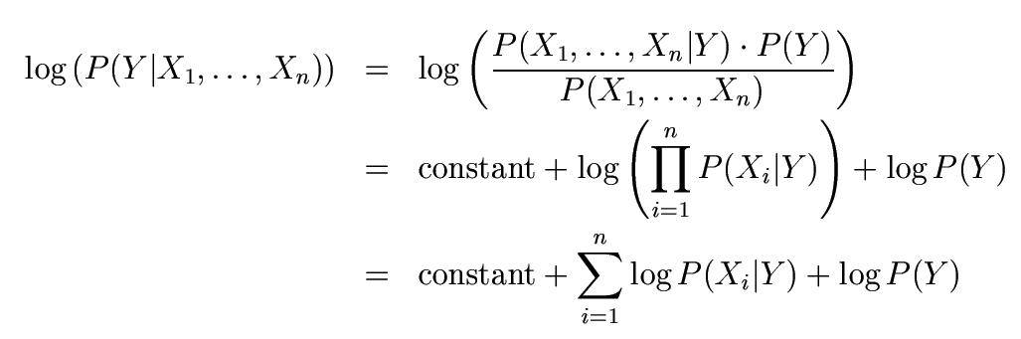
Underflow Prevention

Slide 16
Conclusions
Naïve Bayes based on the independence assumption
Training is very easy and fast; just requires considering each attribute in each class separately
Test is straightforward; just looking up tables or calculating conditional probabilities with normal distributions
A popular generative model
Performance competitive to most state-of-the-art classifiers even in presence of violating independence assumption
Many successful applications, e.g., text classification, real-time prediction, recommender systems, etc.

